Slide 1
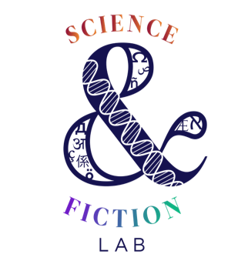
Mission
Literature and STEM are viewed as different star systems, when in fact they are complementary and intertwined. In higher ed the misconception becomes ingrained as the two are set in opposition. FIU’s Science & Fiction Lab has launched an ambitious program to unify the cosmic view and engage our students.
PCC
Portable Course Content: a ready-to-go cluster of lessons that can be interpolated into pre-existing courses in any discipline.
Team
Meet the lab techs, advisory board members, collaborators, and institutional partners!
Jigsaw Modules
Micro-Credentials
Ambulatory course components that teach science fiction, science, and the humanities
Mini courses whose completion earns learners badges that represent competencies gained
Library
Institutes
The digital catalog features six Canvas-hosted “plug-and-play” modules that blend humanities and STEM. These lesson chunks include learning outcomes, recommended texts, assignments, additional resources, and suggestions for outcome assessment.
More to come!
The incubators wherein interdisciplinary pairs of faculty develop PCC in the shape of jigsaw modules, micro-credentials, and COIL
Impact
After just one semester of implementation, hundreds of undergraduates have encountered directed interdisciplinary content—where there was little to none before.
and, students love it!

